Slide 1
Disambiguation as a domain-general strategy: Faces-to-voices, animal vocalizations-to-animals, and gestures-to-objects
Ricardo Bion
Department of Psychology
Stanford University
&
Larissa K. Samuelson
Department of Psychology and Delta Center,
University of Iowa

Slide 2
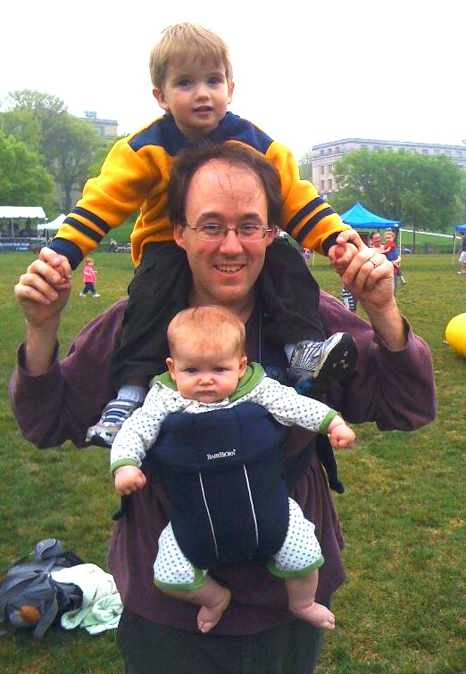

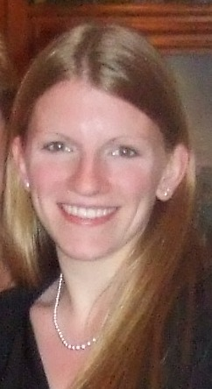
Thanks to…
Jessica Horst
Bob McMurray
Sarah Kucker
NICHD and NIMH for the funding

Slide 3
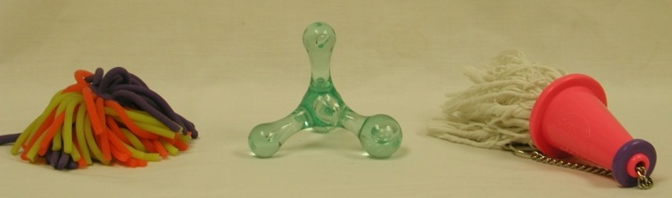
Disambiguation
Roke

Slide 4
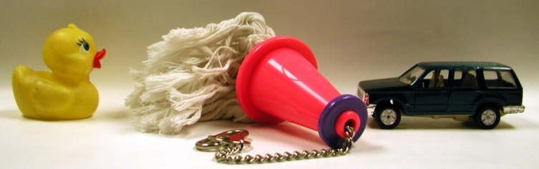
Children really good at it.
Roke
Kucker & Samuelson (2011)

Slide 5

Hebbian Normalized Recurrence Model
Lexical Units
Activate the inputs for the 3 visual stimuli and the novel word.
bug
dog
grass
ball
cat
tree
roke
Auditory
Inputs
Visual
Inputs
McMurray, Horst & Samuelson (2012) Psych Rev.

Slide 6
Hebbian Normalized Recurrence Model
Lexical Units
Activation is normalized and then cycles forward.
bug
dog
grass
ball
cat
tree
roke
Auditory
Inputs
Visual
Inputs
McMurray, Horst & Samuelson (2012) Psych Rev.

Slide 7
Hebbian Normalized Recurrence Model
Lexical Units
…and back
bug
dog
grass
ball
X
cat
X
tree
roke
Auditory
Inputs
Visual
Inputs
McMurray, Horst & Samuelson (2012) Psych Rev.

Slide 8
Hebbian Normalized Recurrence Model
Lexical Units
…and back again
bug
dog
grass
ball
X
cat
X
tree
roke
Auditory
Inputs
Visual
Inputs
McMurray, Horst & Samuelson (2012) Psych Rev.

Slide 9
Hebbian Normalized Recurrence Model
Lexical Units
Until one object is left
active.
bug
dog
grass
ball
cat
tree
roke
Auditory
Inputs
Visual
Inputs
McMurray, Horst & Samuelson (2012) Psych Rev.

Slide 10
Today
Justin Halberda
18-month-olds mapping faces and voices
Ricardo Bion, Kayle MacDonald & Anne Fernald
30-month-olds map novel animal sounds to unfamiliar animals
Sumarga Suanda & Laura Namy
18-month-olds mapping of gestures
Me
Tie it all together with the model

Slide 11
Discussion

Slide 12

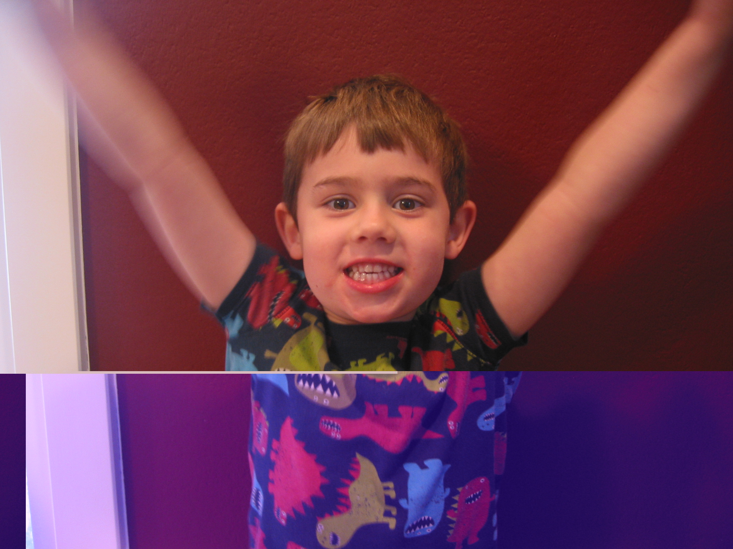


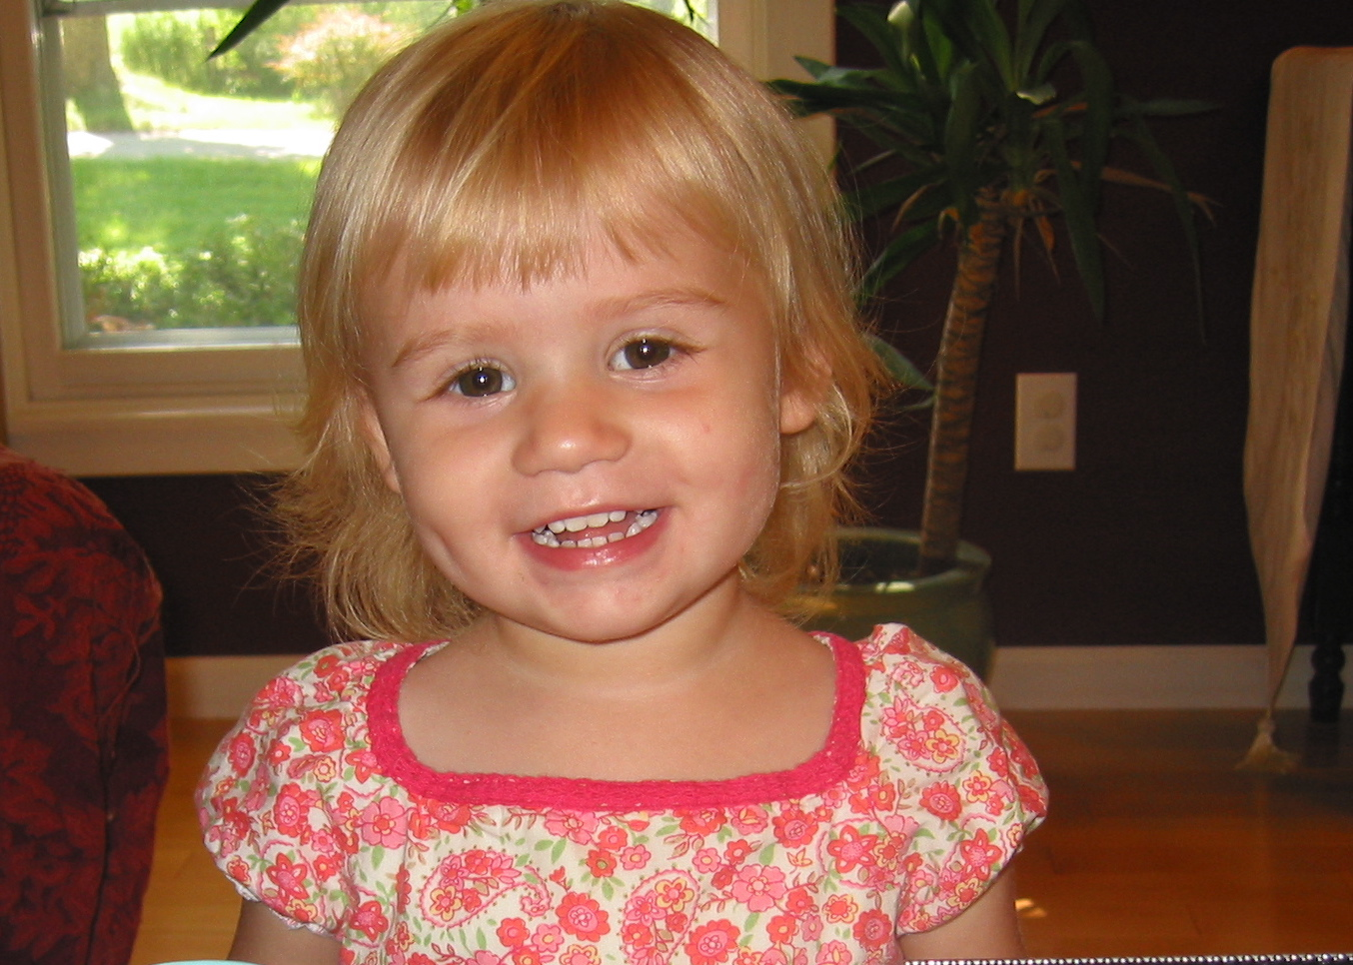
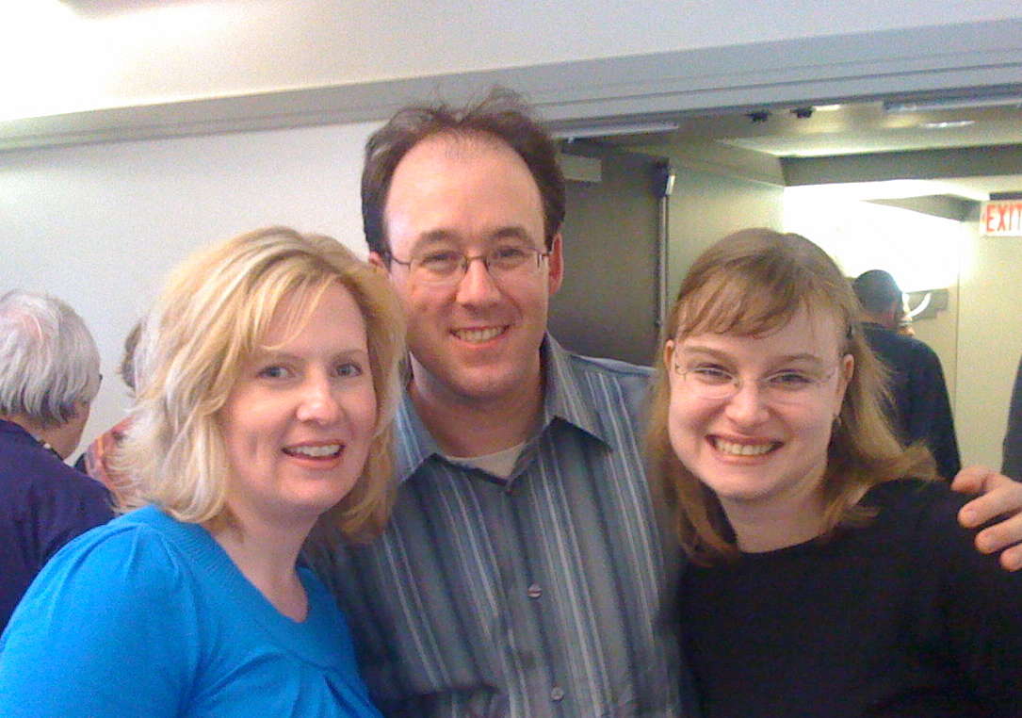
Hebbian Normalized Recurrence Model
Lexical Units
NEW INPUTS!
Katya
bug
Linda
dog
Kadin
grass
John
ball
Alek
cat
Nick
tree
Jessica
roke
Auditory
Inputs
Visual
Inputs
McMurray, Horst & Samuelson (2012) Psych Rev.

Slide 13
Hebbian Normalized Recurrence Model
Lexical Units
What about that learning?
How do the connections get set?
bug
dog
grass
ball
Assume simplest possible mechanism: association.
How far can that get us?
cat
tree
Auditory
Inputs
Visual
Inputs
McMurray, Horst & Samuelson (2012) Psych Rev.

Slide 14
Hebbian Normalized Recurrence Model
Lexical Units
Weights start out fully interconnected.
bug
dog
grass
ball
cat
tree
Auditory
Inputs
Visual
Inputs
McMurray, Horst & Samuelson (2012) Psych Rev.

Slide 15
Hebbian Normalized Recurrence Model
Lexical Units
Strengthen weights
Weaken weights
No change
bug
dog
grass
ball
cat
tree
Auditory
Inputs
Visual
Inputs
McMurray, Horst & Samuelson (2012) Psych Rev.
Notes:
If the input and associated lexical unit are active, strengthen the weight
If the input is active but the lexical unit is suppressed, or if the lexical unit is active but the input isn’t, weaken the weight

Slide 16
Hebbian Normalized Recurrence Model
Lexical Units
bug
dog
grass
ball
cat
tree
roke
cheem
pabe
Auditory
Inputs
Visual
Inputs

Slide 17
Hebbian Normalized Recurrence Model
Lexical Units
Mutual Exclusivity
bug
dog
grass
ball
cat
tree
roke
cheem
pabe
Auditory
Inputs
Visual
Inputs

Slide 18
Hebbian Normalized Recurrence Model
Lexical Units
bug
dog
grass
ball
cat
tree
roke
cheem
pabe
Auditory
Inputs
Visual
Inputs

Slide 19
Hebbian Normalized Recurrence Model
Learning following novel referent selection
Lexical Units
bug
dog
grass
ball
cat
tree
roke
cheem
pabe
Auditory
Inputs
Visual
Inputs

Slide 20
Hebbian Normalized Recurrence Model
Lexical Units
reduces connections
bug
dog
grass
ball
cat
tree
roke
cheem
pabe
Auditory
Inputs
Visual
Inputs
Notes:
IF we take this model then to the slow timescale of in the moment referent selection with a new novel word

Slide 21
Hebbian Normalized Recurrence Model
Lexical Units
Fewer paths for next novel word.
bug
dog
grass
ball
cat
tree
roke
cheem
pabe
Auditory
Inputs
Visual
Inputs

Slide 22
Hebbian Normalized Recurrence Model
Only one path left (in this simple example)
Lexical Units
bug
dog
grass
ball
cat
tree
roke
cheem
pabe
Auditory
Inputs
Visual
Inputs
Notes:
It turns out this has consequences for the slow time scale.

Slide 23
Basis of the model:
Dynamic competition and inhibition
Associative learning
With this have captured:
Learning even in highly ambiguous contexts
Comprehension/production differences
Aspects of bilingual learning trajectory
Learning of taxonomic categories
Lack of retention following reference selection
Order effects with informative naming episodes
McMurray, Horst & Samuelson (2012) Psych Rev.
McMurray, Kucker, Zhao & Samuelson (2013) in Gogate & Hollich

Slide 24
This computational perspective highlights:
The importance of considering timescales
Behavior in the moment based on learning accumulated to that point
Learning on the result of that behavior accumulates over a longer timescale to create behavioral changes
→ Much of this change is negative

Slide 25
Hebbian Normalized Recurrence Model
In this simple associative system, on each epoch, the model must:
+ Build positive associations b/w word & object.
bug
dog
tree
Eliminate associations between objects not present & current word.
Eliminate associations between unheard words and present objects
Avoid building positive associations b/w word & competitors.
McMurray, Horst & Samuelson (2012) Psych Rev.

Slide 26
Hebbian Normalized Recurrence Model
Associative learning is more about eliminating unnecessary connections than forming positive associations!
Even if you “know” a word – you still have a lot of other things to do.
Has implications for familiar word recognition
Model captures changes in speed of processing
from 15-24 months-of age.
McMurray, Horst & Samuelson (2012) Psych Rev.

Slide 27
This computational perspective highlights:
The importance of considering timescales
Behavior in the moment based on learning accumulated to that point
Learning on the result of that behavior accumulates over a longer timescale to create behavioral changes
Tie between familiar word recognition and novel word learning
Break the model to see what is necessary and
see the contributions of each part

Slide 28
Hebbian Normalized Recurrence Model
Reduce Inhibition
Take out lexical units
Lexical Units
bug
Can still learn
Doesn’t show
Mutual exclusivity anymore
dog
grass
ball
cat
tree
Auditory
Inputs
Visual
Inputs
McMurray, Kucker, Zhao & Samuelson (2013) in Gogate & Hollich

Slide 29
New Data!
Halberda
Novel Voice → look to novel face
Bion, MacDonald, Fernald
Novel animal sound → look to novel animal

Slide 30
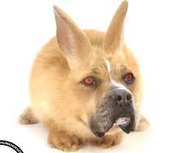
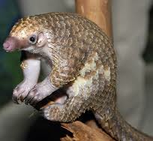
Lexical Units
bug
dog
Auditory
Inputs
grass
Visual
Inputs
ball
cat
tree
roke
slurp slurp
woof
cha cha cha
Alek
Katya
Linda
Kadin
Nick
Notes:
And these nodes must be connected into the same associative matrix because we know inhibition and lexical units are what get us mutual exclusivity.

Slide 31
New Data!
Suanda & Namy
Novel gestures → look to FAMILIAR object
Model tells us either not same lexical units or not inhibited to the same degree.
But children will map gestures to objects at this age.

Slide 32
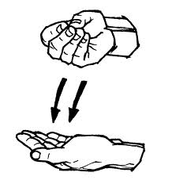

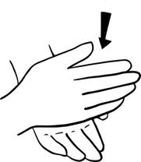
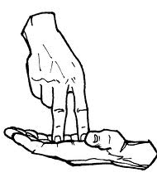
Lexical Units
bug
dog
Auditory
Inputs
grass
Visual
Inputs
ball
cat
tree
roke
slurp slurp
woof
cha cha cha
Alek
Katya
Linda
Kadin
Nick
Notes:
Of course there is another way to do it…

Slide 33
Lexical Units
bug
slurp slurp
dog
woof
grass
cha cha cha
ball
Alek
cat
tree
Katya
roke
Linda
slurp slurp
Kadin
woof
Nick
cha cha cha
Alek
Katya
Linda
Kadin
Nick
Notes:
Of course there is another way to do it…

Slide 34
Lexical Units
slurp slurp
woof
cha cha cha
Alek
Katya
Linda
Kadin
Nick
Notes:
Of course there is another way to do it…

Slide 35
Lexical Units
b
Pos. 1
d
four legs
g
plant
animal
a
has fur
Pos. 2
i
o
has whiskers
tall
s
Visual
Feature Inputs
Pos. 3
r
m
Visual
Categories
(Learned)
Auditory
Inputs
McMurray, Kucker, Zhao & Samuelson (2013) in Gogate & Hollich

Slide 36
This 4-layer version of the HRN shows:
Visual layer self-organizes before visual-to-auditory associations are learned (c.f., Kucker & Samuelson, 2012; Mayor & Plunket, 2010).
Similarity in the visual features delays auditory-to-lexical links.
Early in learning auditory interferes with visual categorization (e.g., Robinson & Sloutsky, 2004) but
Auditory inputs results in stronger category mappings eventually (c.f., Lupyan, Rakison & McClelland, 2007, Perry, 2012).

Slide 37
The big question
Domain General or Domain Specific?
(pigeons show disambiguation in a word learning task)
Or start general and go specific
Correlation between vocabulary and disambiguation.
Model shows this (Fernald SOP data) because as it learns it changes the associative matrix.
In the 3-layer version this is tied to lexical units
But in 4-layer learning about object features changed the way lexical learning happened.
So learning OUTSIDE of language, about categories, sounds, gestures, facial expressions, etc. can influence the way disambiguation occurs.

Slide 38
The big question
Domain General or Domain Specific?
This is really a question about inputs.
The model suggests the action is with the processes that act on those inputs.

Slide 39
The big question
Dynamic Competition, Inhibition and Associative Learning are able to capture multiple aspects of the development of disambiguation as well as a number of other aspects of early word learning
and they are very domain general.

Slide 40
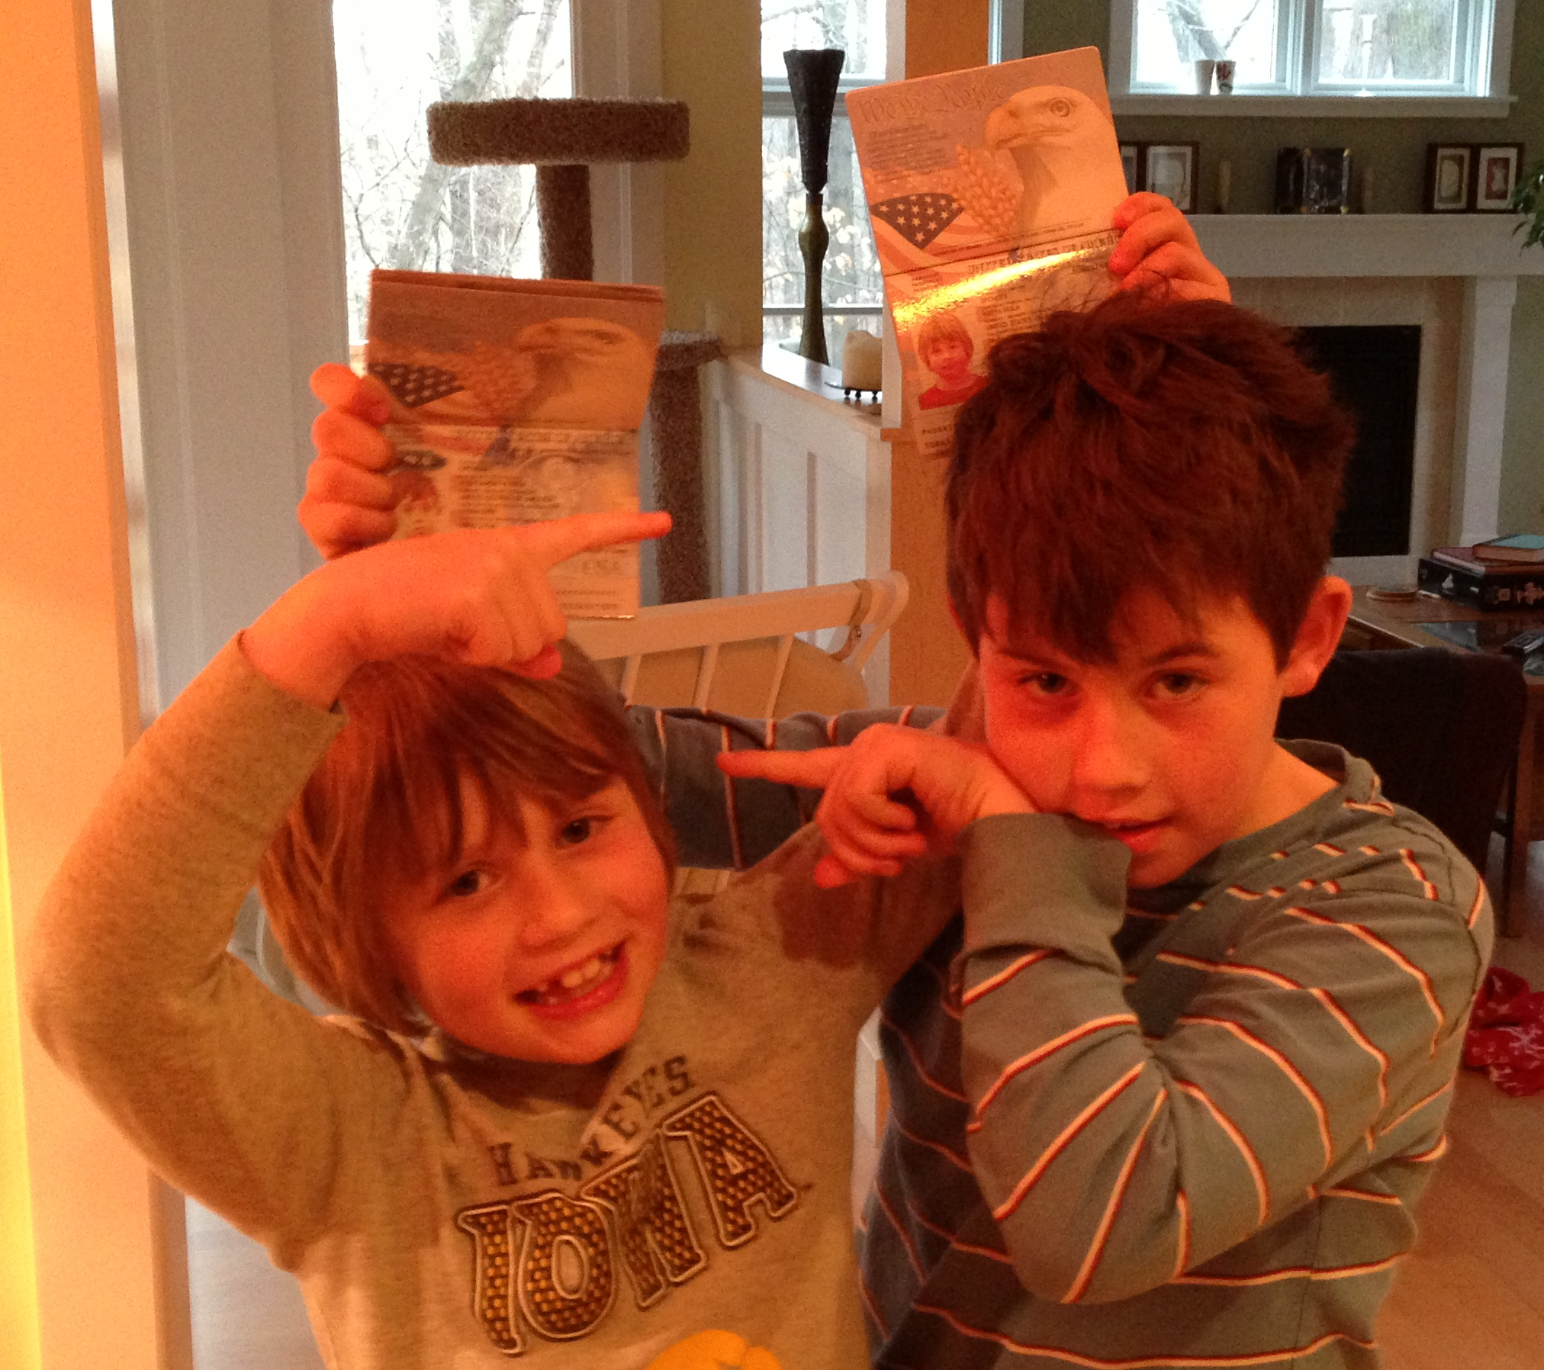
THANKS

Slide 42
Hebbian Normalized Recurrence Model
Lexical Units
Weights start out fully interconnected.
Tuned over learning to associate each word/object with one lexical entry.
bug
dog
grass
ball
cat
tree
Auditory
Inputs
Visual
Inputs
McMurray, Horst & Samuelson (2012) Psych Rev.

